Slide 1

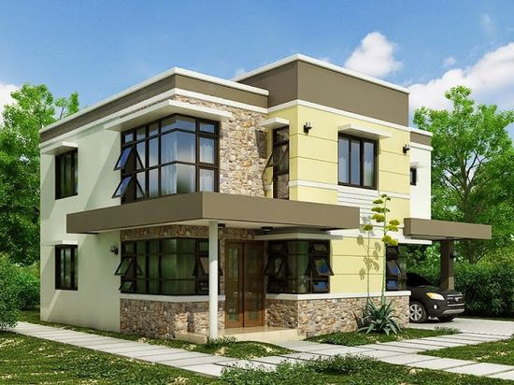

REAL ESTATE BOOKING WEBSITE
Presented by: Ananya Agrawal

Slide 2

Overview
Problem Statement
What is Real-estate
Features of Website
Technologies used
Flowchart
Working
Home Page
Add property page
future scope

Slide 3


Problem Statement
Current Real Estate Booking websites lack user-friendly interfaces, struggle to provide comprehensive property information, and lack efficient communication tools between buyers and sellers. There's a need for a platform that simplifies property search, improves data quality, and streamlines communication for a better user experience.

Slide 4
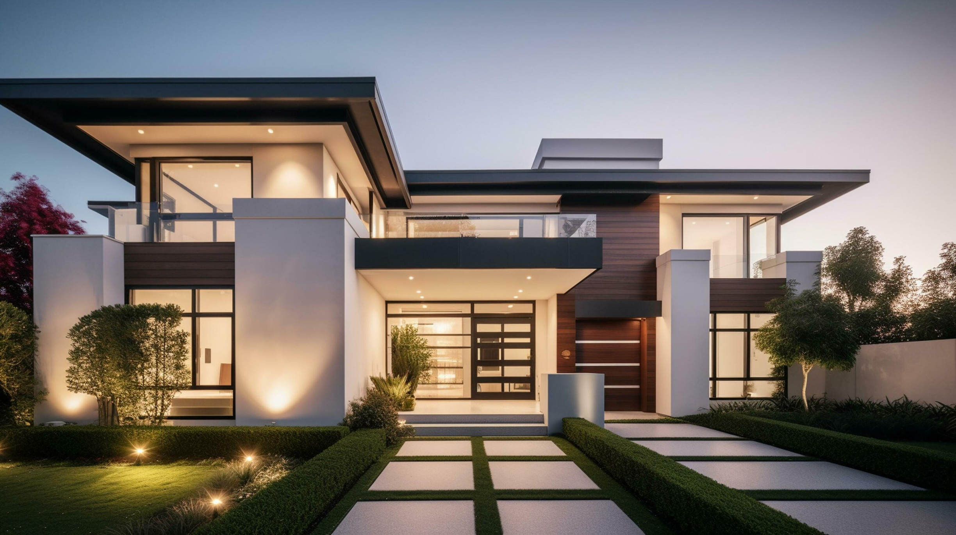
What is Real-Estate
Real Estate refers to property consisting of land, buildings, natural resources, and other improvements on the land. It encompasses residential, commercial, and industrial properties. Real estate can be bought, sold, rented, or leased, and it's often considered an investment because property values can appreciate over time.

Slide 5

Features of Real-Estate Website

Slide 6





Language Used
Backend Connectivity
HTML
NodeJs
CSS
Express Js
JavaScript
Database
React
Mongodb

Slide 7
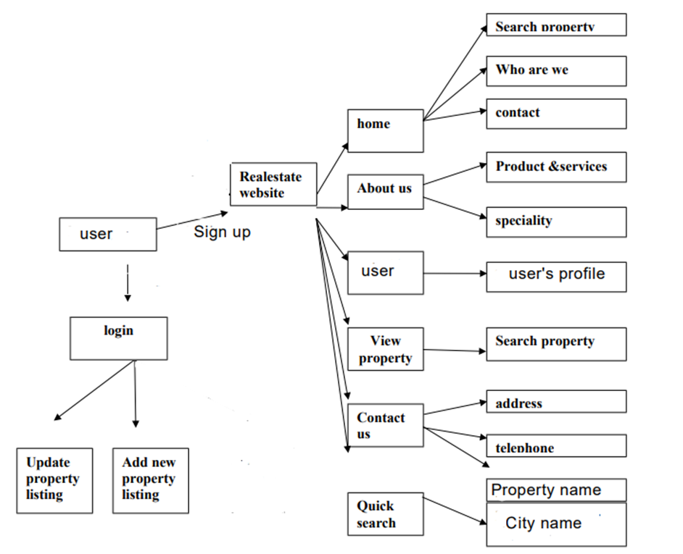


Flowchart

Slide 8


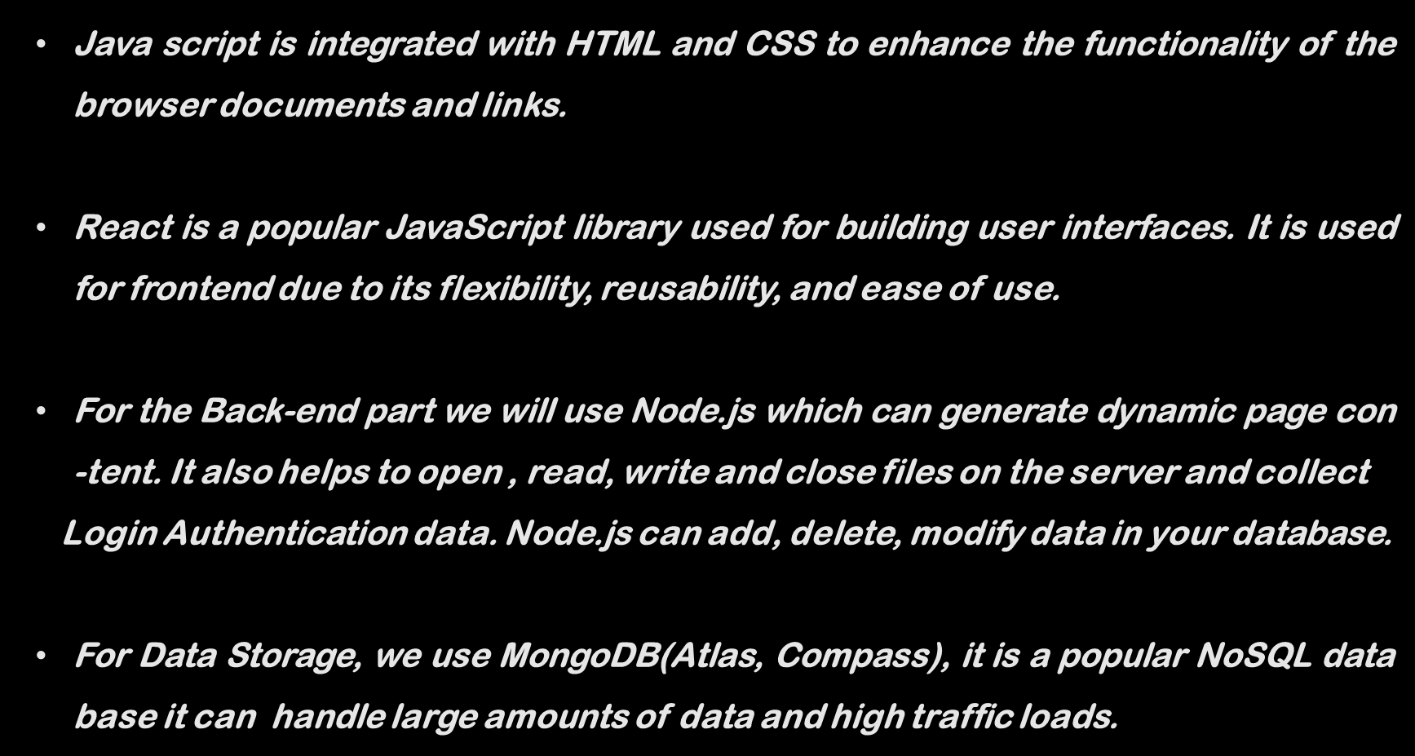
Working

Slide 9




Future Works
User Review and Ratings
Payment Gateway Integration
Mobile Application Developemnt
Social Media Integration
Implement a user review and rating system where users can provide feedback and ratings for properties they have booked or visited.
Adding the Payment
help user in Securely doing the trasation of the property
Consider expanding the project by developing a dedicated mobile application for iOS and Android platforms.
Integrate social media sharing capabilities, allowing users to easily share properties or their booking experiences on social platforms.

Slide 10
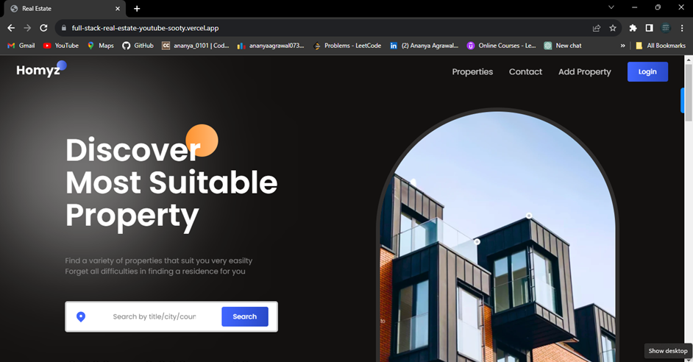
Home Page

Slide 11
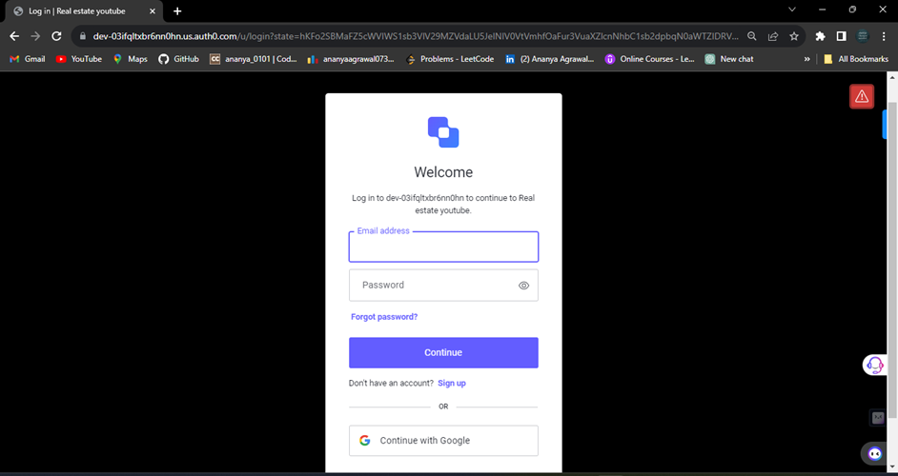
Login and Sign up Page

Slide 12
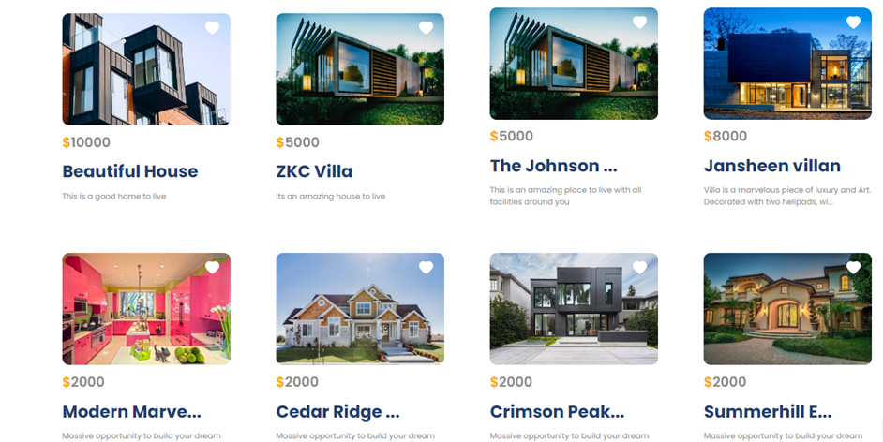
Property Listing Page

Slide 13
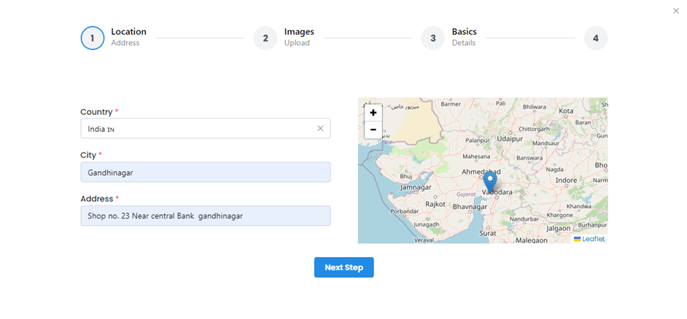
Adding new property

Slide 14
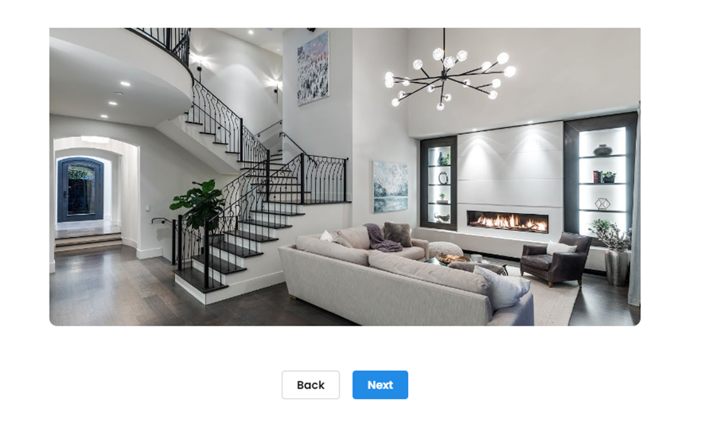

Adding new property

Slide 15
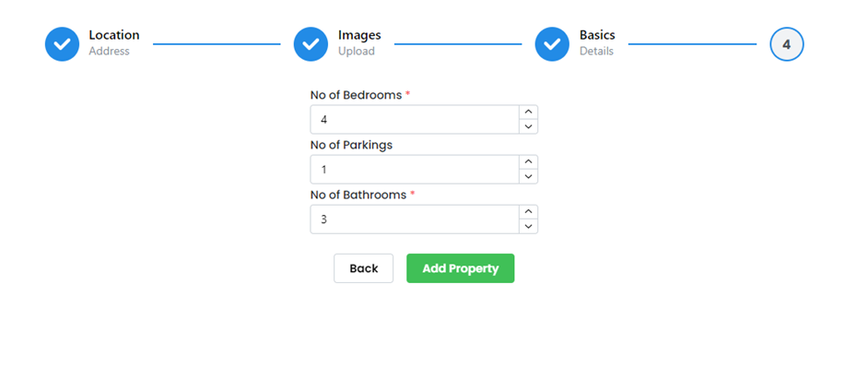
Adding new property

Slide 16
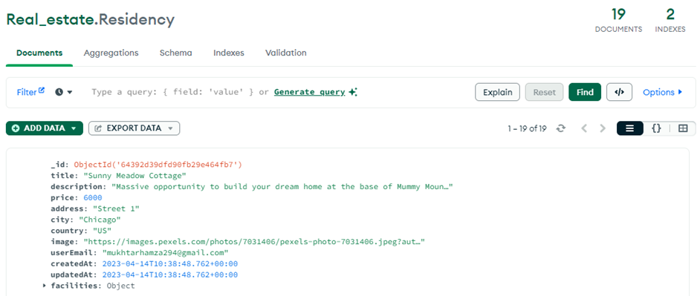
Residency Database

Slide 17
THANK YOU

